Slide 1
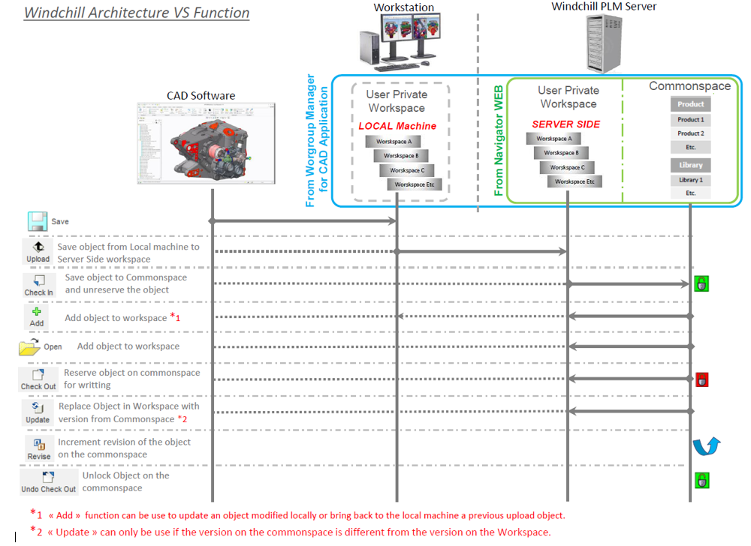



Slide 2
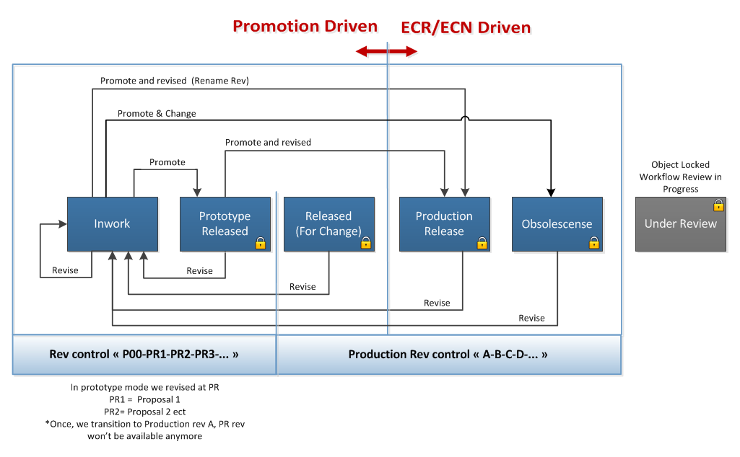
Tire Product – CAD Document Lifecycle

Slide 3
Tire Product & Mold Approval Workflow
“Promotion Request Process”
Creator
Rework as per review
Submit new Promotion Request
Review 1
(Design Check)
Review 1
Require
Yes
First Review
Decision
Reject
Rework or R2 app. & R1 Rework
No or R1approved
Approve/Rework
Review 2
(R&D Check)
No R2 & Rework
Notification
Review 2
Require
Yes
Review
Level 2
Decision
Reject
Rework
No or R2 approved
Approve
Approver
Approve
Final
Approval
Decision
End
Reject

